Slide 1
DS530
Concept, overview and principles

Slide 2
Syllabus Overview

Slide 3
Big Data
Concept, overview and principles

Slide 4
What is Big Data?

Slide 5
Definition
Different from “a lot of data”
Big data is defined by 3V:
Volume – large amounts of data
Variety – data from in different forms
Examples?
Velocity
content of data changes
Streamed from multiple sources
Notes:
Variety – traditional DB, images, documents, complex records, unstructured

Slide 6
Big Data Analysis
Data is extracted, filtered and transformed
Data is processed in piecemeal, recursive manner

Slide 7
What are examples of a big data problem? What are the reasons?

Slide 8
Big Data vs Small Data
Goals
Small data – designed to answer a specific question
Big data – has a goal in mind but the goal is flexible
Location
Small data - usually one file, on a computer
Big data – spread throughout in multiple places, servers, around the globe
Structure and content
Small data- usually structure
Big data - unstructured
Notes:
Video, text document, sound recording, images…

Slide 9
Data preparation
Small data – data user prepares their own data, for their purpose
Big Data – comes from diverse sources, prepared by many people
Longevity
Small data – data is kept for a short period of time after project ends
Big data – stored for a long period of time
Measurements
Small data – one experiment
Big data – measurements obtained by many sources

Slide 10
Reproducibility
Small data – projects are typically reproducible
Big data- big data project is seldom reproducible
Costs
Small data – limited and small
Big data – expensive
Introspection
Easy to find a specific data point (row, column)
Use introspection techniques
Analysis
Small data – data can be analyzed all at once
Big data – analyzed in incremental steps
Notes:
Introspection – encapsulation information in a data object, the technique to interrogate / find out about the information that associate with the object

Slide 11
Common Purpose of Big Data
Data selection comes from big data,
Organize the complex data
Ultimate analysis usually confines to a small dataset, ready for query
Common role of big data is to produce small data

Slide 12
Provide structure to unstructured data
Nearly all data is unstructured, and unusable in its raw form
What are examples of unstructured data
Examples of structure data

Slide 13
Examples of Unstructured Data:
Message, book, video, images, tweet, email, web page, news, advertisement, download music ..
Structure – cells in spreadsheet, database
To get information from free text:
involve translating the text to a preferred language
parsing the text into sentences;
extracting and normalizing the conceptual terms contained in the sentences

Slide 14
Concordance
A list of the different words contained in a text with the location of the text where each word appears.
What is the algorithm or steps to create a concordance from a text or book

Slide 15
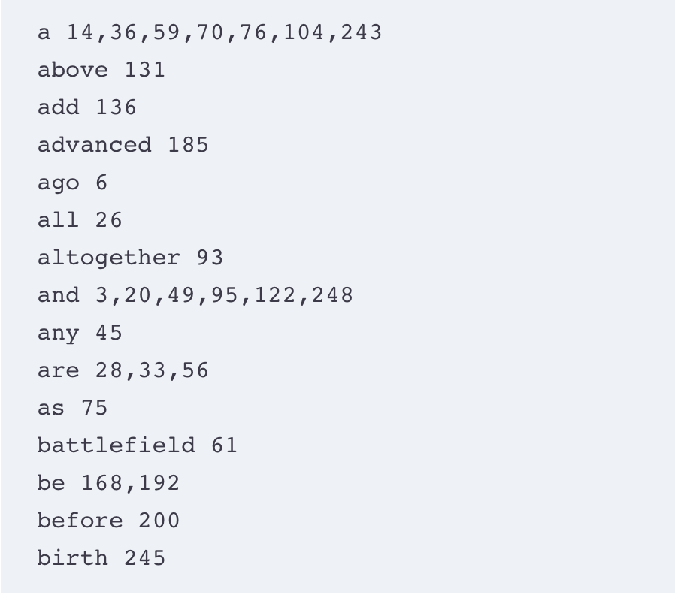
.
Step:
Write down each word, and location e.g. word 1, page 1, word 2, page 1
When you come to an existing word, add it to the word list

Slide 16
Useful Properties of Concordance
Rapidly search and retrieve the locations where single-word terms appear.
Reconstruct the original text from the concordance. Hence, after you've built your concordance, you can discard the original text.
Merge concordances without forfeiting your ability to reconstruct the original texts, provided that you tag locations with some character sequence that identifies the text of origin.
A dictionary can be transformed into a universal concordance (i.e., a merged dictionary/concordance of every book in existence) by attaching the book identifier and its concordance entries to the corresponding dictionary terms.
Easily find the co-locations among words (i.e., which words often precede or follow one another).
To retrieve the sentences and paragraphs in which a search word or a search term appears, without having access to the original text.
Reconstruct and retrieve the appropriate segments of text, on-the-fly, thus bypassing the need to search the original text.
Provides a profile of the book and can be used to compute a similarity score among different books.

Slide 17
Term Extraction
To build an index -> need to understand the terms in the text
Extract terms:
Common word – also known as stop word and barrier word
Remove common word
Keep a list of terms and the locations

Slide 18
Index
Index – capture the intent and content of the book/text
Related concepts are collected under common terms and their locations
A book may have 5 or more indexes
Goal of indexer
Keyed encapsulate of concepts, sub-concepts and term relationships
Electronic index - Important concept in Data data resource
Map concepts classes, and terms to specific location in the sources where data items are stored.

Slide 19
Autocoding
Nomenclature – a specialized vocabulary, containing terms for a specific domain
Coding (in this context)
process of tagging terms with an identifier code that corresponds to a synonymous term listed in a standard nomenclature.
Example in medical nomenclature
renal cell carcinoma, a type of kidney cancer, has a unique identifier code for such as “C9385000.”
synonyms and near-synonyms are assigned the same unique ID.
Similar terms similar to renal cell carcinoma, such as cancer arising from kidney, carcinoma of kidney, Grawitz tumor
Notes:
system or set of terms or symbols especially in a particular science, discipline, or art

Slide 20
Coding text –
Find terms
belong to a specific nomenclature (over a knowledge domain) e.g nomenclature of automobile, software, diseases, astronomy, chemistry…
Tag each term with a ID
It is a serious and important task
What are issues with Human Coders?

Slide 21
Issues with human coders
Time consuming for big data
Prone to error
inconsistent
Autocoding – computerized coding
A specialized form of machine translation
Find terms in text and matching them with the nomenclature terms
Using natural rules of language to find words/phrases and attach them to nomenclature terms
Need to take care of stemming, grammatical variants
Similar rate as auto-correct, auto-spelling and look ahead

Slide 22
3 Approaches for Auto-coding
regEx (regular expression)
Lexical parsing
On the fly coding

Slide 23
Lexical Parsing
parsing text, word by word, looking for exact matches between runs of words and entries in a nomenclature.
Let’s go over the lexical parsing algorithm

Slide 24
On the fly coding
involves parsing through a text of any size, and searching for all the terms that match one particular concept (i.e., the search term).
Let’s go over the on the fly coding algorithm
(before section 2.6)

Slide 25
Identification, De-identification and Re-identification
Proper identification of unique data objects
De-identification and re-identification
Why do we need de-identification of data objects?

Slide 26
de-identification of data objects
Issues of confidentiality, privacy, intellectual property

Slide 27
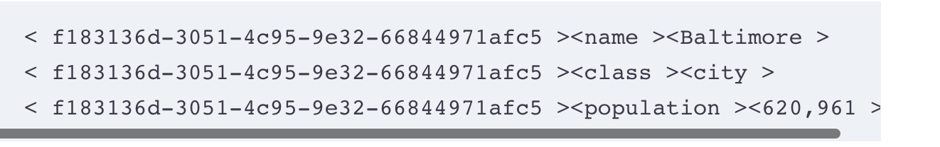
What are identifiers?
What is object?
Is 10 a data object?
In computer science, data object is something that can be
Identified
described
What does the above statements tell us?
Notes:
Yes o no. 5 is an integer. But it has no meaning unless it bind with another object – 5 pairs of shoes…

Slide 28
Data object consists of unique alphanumeric sequence, and
Descriptive information associated with the identifiers
We also need a dependable identifier system

Slide 29
Important Ideas
Without adequate identification system, big data resource has no value -> cannot be analyzed
De-identification – process where links to public name of the object has been removed
An de-identified object has identifiers associated with it.
Re-identification – involves personal and private data records.
Make sure the individual who is associated with a de-identified record.
Need to verify the content of a record

Slide 30
Identifier and Identification System
Identifier - distinguish one object from another
An identifier system creates a permanent environment in which the identifiers are safely stored and used.
Attributes of a good identification system: Completeness – every unique object in the system is assigned an id
Uniqueness – each identifier is a unique sequence
Exclusivity – each identifier is assigned to a unique object, and no other object
Authenticity – the object that receive identification must be verified as the object it intended to be
Aggregation – ability to collect all the information associated with an identifier.
Notes:
Example of a bank – person walk to the bank to withdraw money

Slide 31
Attributes (continued)
Permanence – the identifiers and the associated data must be permanent
Reconciliation – merged together with the data held in another resource for the same unique id.
Immutability – if two objects need to be merged from different resources
An object with be assigned two identifiers, one from each resources
Identifiers must be preserved.
Security
Documentation and quality assurance
Problems must be identified, corrected, documented
Centrality – the identifier is the central to all transactions related to the object
Autonomy – life of its own.
Notes:
Permanence – e.g. patient / never destroyed or lost
Reconciliation – records of patients in different hospitals

Slide 32
Bad identifiers
Name – why? Section 3.4
Some identifiers are not random but contains sequence that can be interpreted
2005-01-10-00834-100

Slide 33
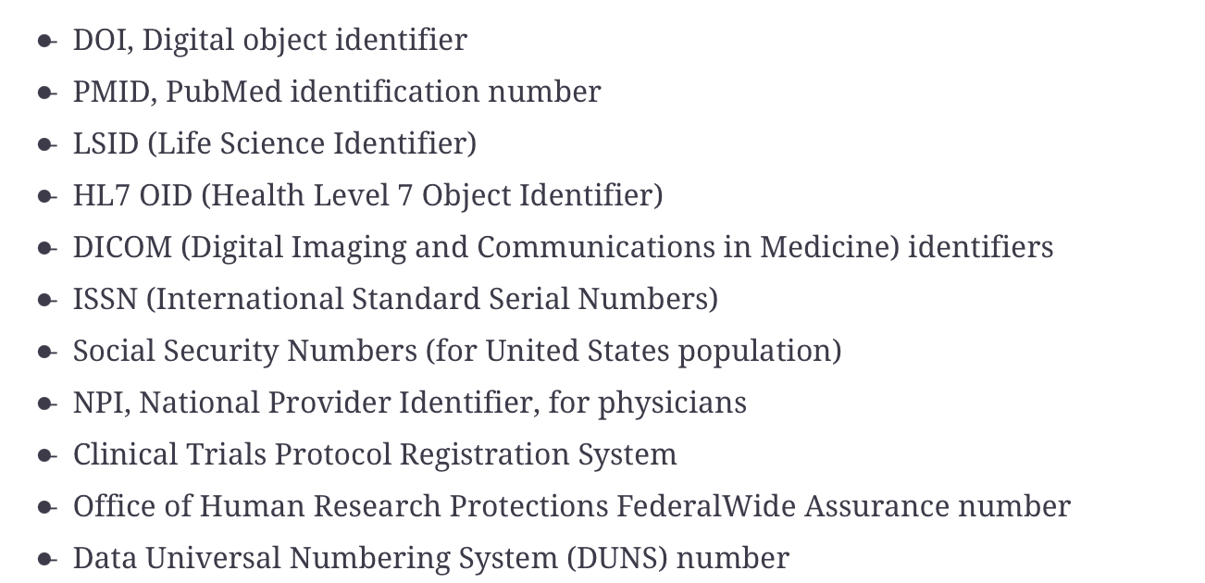
Register Unique Identifiers
Registries are trusted services that provide unique identifiers to objects.
provide a general identifier sequence that will apply to every data object in the resource.

Slide 34
De-identification
Purposes:
Protect the confidentiality and the privacy of the individual
Remove information that might bias the experiment
Strip information that link to the public name of the record’s subject
Examples of information being stripped?
Deidentification is successful only when each record is properly identified
Notes:
Connect patient and record

Slide 35
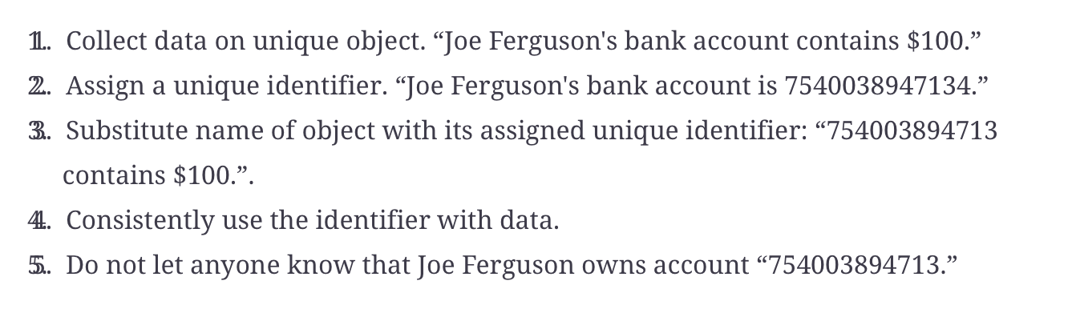

Slide 36

Confidential statement:
Deidentified statement makes no harm

Slide 37
Data Standard and Protocol
Why do we need them?
What are the challenges?
Notes:
Interoperability
Protocol – convert well defined data into a conformed standard format
Model data and process

Slide 38
There are many data standards – healthcare, financial, network, telecom
Versioning
Incompatible
Increase in complexity over time
Data standards vs data specification
Data standards vs data specifications

Slide 39
Differences Between Data Standards and Data Spec
Data spec
Doesn’t describe every type of data
Provide general form and descriptive features of a well-described data object
Data standard
Every type of data, format
E.g. HL7 – a set of international standards for transferring clinical and administrative data between software applications used by various healthcare providers

Slide 40
Big Data
Data standard for data objects
A specific set of protocol to convert the well-defined data into a conformed standard format
Key to data integration among diverse big data sources

Slide 41
Example of Standards
Writing a letter (non-self) – salutation, content, name, signature
Reminder notes for yourself (self)
Many ways: email, voice record, post-it note
Self: not focused on data integration
Sharing the data across networks may involve the use of many different interchange protocols.
Notes:
Self: free

Slide 42
Concept of Data Integration
Easy to use the data for data systems within organization or corporation
Share data outside of organization boundaries
Standards are needed
Databases from different vendors
Different data models
Human to databases
Exchange of one data source to another

Slide 43
Challenges
Version
Abandon unpopular standards
Increase in complexity over time
The number of standards available

Slide 44
There is no guiding force
No governing body or authority to limit new standards
No guidance or procedures
Standards can be easy to create, especially if they are narrowed focus
Easy to write, document and publish it as a journal article
Standard process – time consuming, costly
Standards are highly profitable, generate revenue
Any vendor can start create a standard
Vendor locks in
patent farming or patent ambushing - The practice of hiding intellectual property within a standard or device
Corporation – obtain patents on standards

Slide 45
It is popular
Everyone wants to own one
Status symbol
XML markup language
no guidance on re-use
No effort to harmonize them
Personalized standards - Scientists still think the way they organize the data should be standard
Many standards were created in the past, before big data era
In the past, create a particular type of object (document…), do it the same way
To compare and categorize
E.g. birth certificate, death certificate
What is the purpose of a standard in Big Data?

Slide 46
The purpose of a standard is to enable data analysts to relate data objects within a document to data objects contained in documents of a different kind.
Example:
Analyze data in death certificate database and patient database
The phenomenon of data integration over heterogeneous sources is repeated in virtually every Big Data effort
In an earlier era, standards served to create data homogeneity. In the Big Data era, standards should help us find the data relationships in heterogeneous data sources.

Slide 47
A “standard” is a set of construction rules that tells you how to represent a required set of information.
For a standard to have value, it generally requires approval from a standards-certifying organization (such as the ISO), or from some large and influential industry group.
The strength of a standard is that it imposes uniformity; the weakness of a standard is that it has no flexibility and impedes innovation.
The strength of the specification is that it is highly flexible; the weakness of the specification that its flexibility allows designers to omit some of the information required to fully specify the object.

Slide 48
Challenges of Standards and Specifications
New versions may appear, without much notice, and the new versions may not be fully compatible with older versions.
Both standards and specifications may be overly complex.
There are too many standards and specifications from which to choose.

Slide 49
Tips
Learn how to decompose the standard document into an organized collection of data objects that can be merged with other data object collections or inserted into a preferred data model.
If feasible, avoid using any standard as your data object model for the resource. It is often best to model your own data in a simple but flexible format that can be ported into any selected standard, as needed.
Know the standards you use. Read the license agreements. Keep your legal staff apprised of your pending decisions.
Try your best to use standards that are open source or that belong to the public domain.

Slide 50
Versioning
E.g standard format of data reporting e.g. patient records, pathology report, incident reports
Challenges – different versions
Modifications
Nomenclatures in every area are being constantly updated
New terms added, old terms deleted
Relationship between terms – update
Changes requires months/years to adopt
What are other examples of reports?
Notes:
Issues – fields, type, missing fields

Slide 51
Compliance Issues
Each vendor – different views of standard compliance
Standard organizations don’t have time to enforce standards or ensure compliance
Challenges – incompatibility
Deviation from standards implemented by vendors
Vendors lock-in
Data specification – easier
Syntax and general description of data objects
Not how the data is structured

Slide 52
Well formed
A file conform to the syntax of a specification
Valid
A file confirms to the document on how data objects should be annotated (which tag to use, relationship between tags ..)
Fully complaint with the spec
The file is well formed and valid.

Slide 53
Overview
Data analyst determines data is
Accurate
Comprehensive
Representative
Organized sensibly
Provide with enough annotation
Via looking at data samples

Slide 54
Looking at the Data
Study the raw data - Quick assessment if you can use the data
Find a free ASCII editor – for plain ASCII text
Emacs and vi
Commercial word editor may fail to open large files (GB)
Download the readme or index file
Readme - explain the purpose, contents, and organization of all the files.
Index - providing a list of terms covered in the files and their locations in the various files.
Assess the number of records in the big data resource
Notes:
Readme, index file – like a map
Number of records – to assess if there are enough data

Slide 55
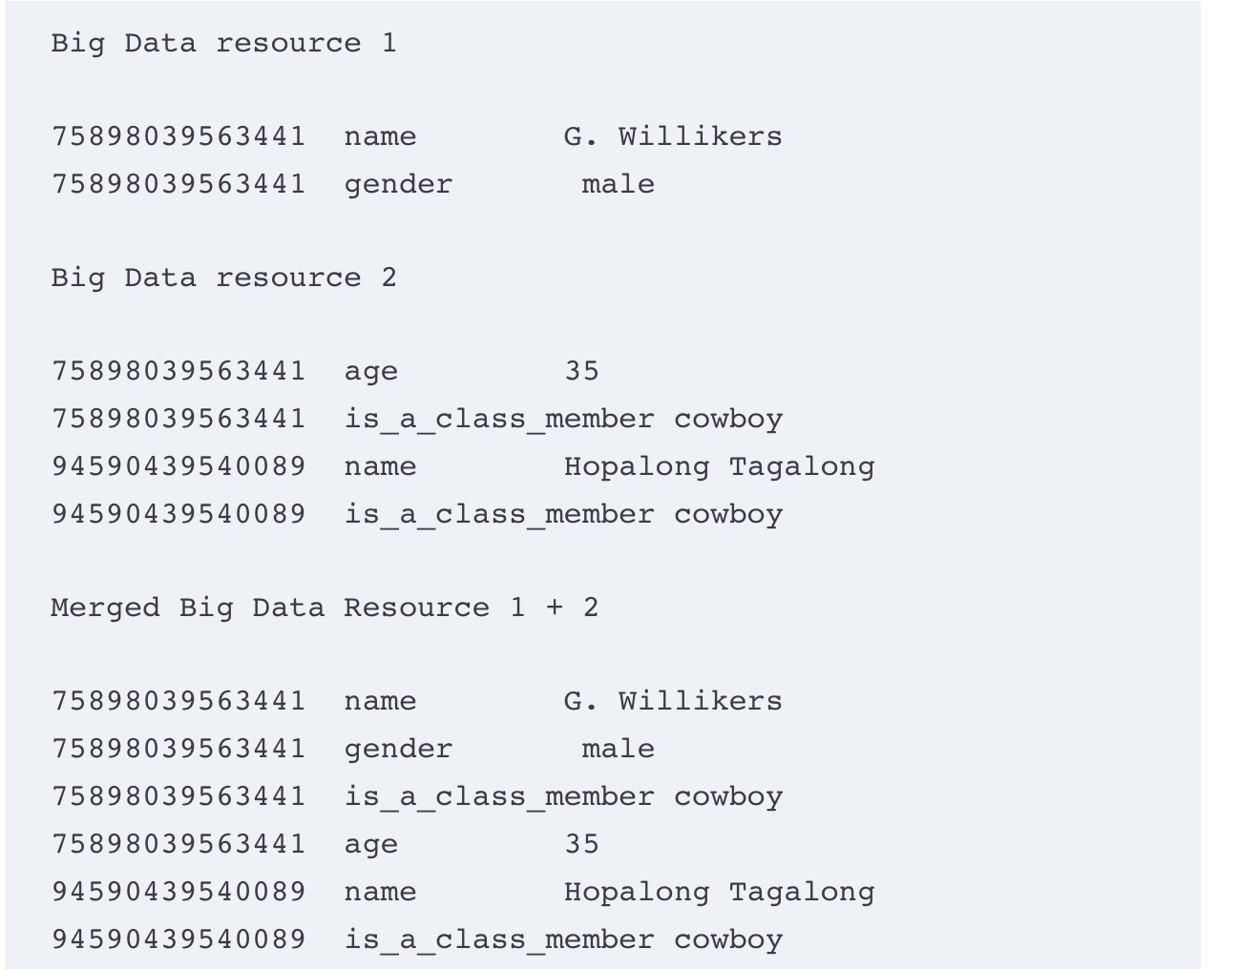
Determine how the data objects are identified and classified
If you know the id of the data object, you can collect information associated with the object no matter where the object is located

Slide 56
Determine if data objects contain self-descriptive information
Contains meta-data
If the data is complete and representative
E.g. use python data science techniques
Use techniques to summarize the data
Plot the data
Visualize the data – plotly, matplotlib
Trend – linear, exponential …
Estimate the solution to the big data project on day 1

Slide 57
Minimal Necessary Property
Small data – do not need a lot of metadata and identifiers
Big Data – volume, variety and velocity requires
Annotation and curation
Data must be assessed to verify, validate and re-analyze the collected data

Slide 58
Universal properties of good data:
Data that has been annotated with metadata
Metadata – data about data
E.g. XML is a modern specification for metadata
Data that establishes uniqueness or identity
Unique identifiers
Allow to collect information about the data
Time stamped data that accrues over time
Measures how the attributes of data change over time – linear, non-linear, Bell curve …
Find trends/patterns in data, prediction
New data with absence of old data has no value
Data that resides within a data object
With an identifier, data/metadata associated with the identifier

Slide 59
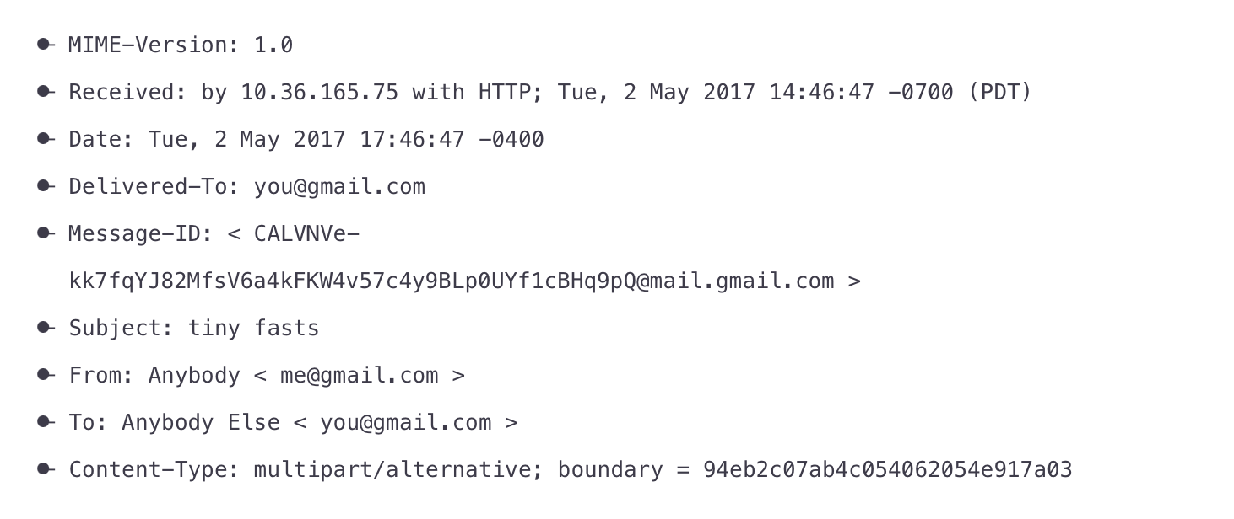
Data that has membership in a defined class
E.g. object class with a set of features, relationship to other objects
Classes in programming language
Introspective data—data that explains itself
Information about the object –identifier, metadata, values
To find out about the data object

Slide 60
Immutable data – pre-existing data cannot be changed
i.e. they are not tainted
Can be verified and validated
Data that has been simplified
Big data is complex, difficult to understand

Slide 61
Data that Comes with Condition
Strict restriction to access the data
Security to protect data
Permission to access data
Sign NDA
May not be necessary if data is de-identified

